Slide 1

Computer security project
Esraa Ali Albahrani-221425419
Thana Essa Alradhi-219023255

Slide 2
Introduction
This project compares the Playfair Cipher, a traditional encryption technique, with other earlier encryption methods by going into great detail about it. The Playfair Cipher, so named for its creator, Charles Wheatstone, is an intriguing case study that provides insight into the inventiveness of early cryptographic schemes. Unlike many of its contemporaries, the cipher's unique process encrypts pairs of letters instead of single ones. We may learn a great deal about the development of cryptographic systems by examining this and other similar classical ciphers. This concept is important because it lays the groundwork for contemporary cryptography.

Slide 3
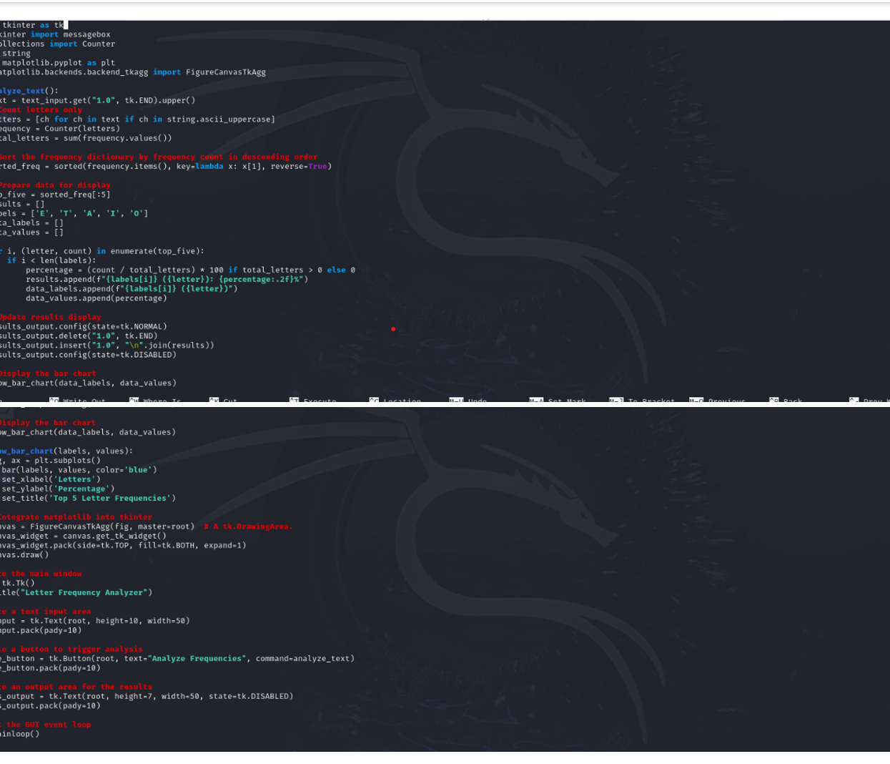
Analysis of frequency of letters in a text paragraph Program to count the frequency of letters in each Text paragraph, and map top highest 5 characters against E –T- A- I – O.

Slide 4
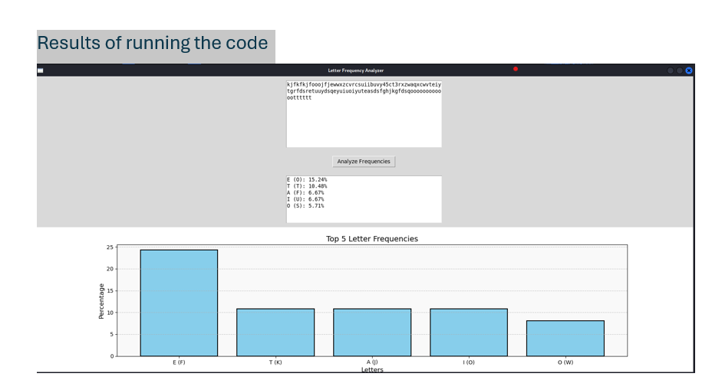
Results of running the code

Slide 5
PLAYFAIR CIPHER
Historical Significance: The Playfair cipher was the first practical digraph substitution cipher12. It was invented in 1854 by Charles Wheatstone but was named after Lord Playfair who promoted its use.

Slide 6
How it works:
1. Key Square (5×5):
•The key square is a 5×5 grid of unique alphabets that serves as the key for encrypting the plaintext.
2. Encryption Process:
• The plaintext is divided into two-letter groups, known as digraphs. If the total number of letters is odd, a ‘Z’ is appended to the final letter.

Slide 7
Rules for Encryption:
If both letters fall within the same column, select the letter directly beneath each one, cycling back to the top if you reach the bottom.
If both letters are in the same row, choose the letter immediately to the right of each, returning to the far left if you're at the far right.
If neither rule applies, create a rectangle using the two letters and take the letters from the horizontally opposite corners of the rectangle.

Slide 8
Example:
Encrypting the word "instruments":
After splitting: 'in' 'st' 'ru' 'me' 'nt' 'sz'
Applying the rules:
"me" becomes "cl"
"st" becomes "tl"
"nt" becomes "rq"
Encrypted text: "gatlmzclrqtx"

Slide 9
The Playfair cipher has several limitations, which are important to consider:
• Key Length and Reusability
• Limited Alphabet and Key Space
• Frequency Analysis
• Known Plaintext Attacks

Slide 10
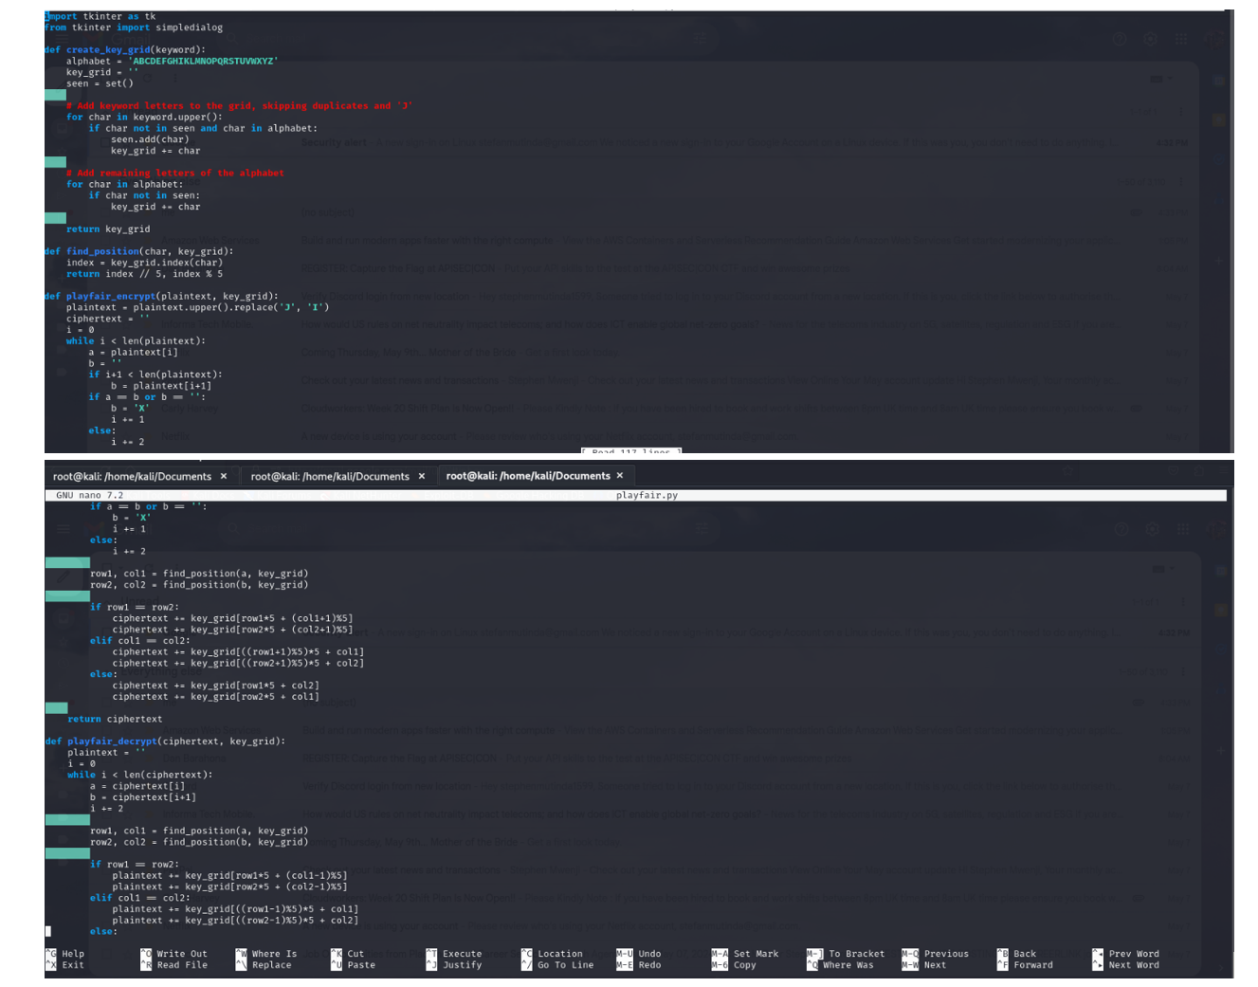
Implementing the code for Playfair Cipher

Slide 11
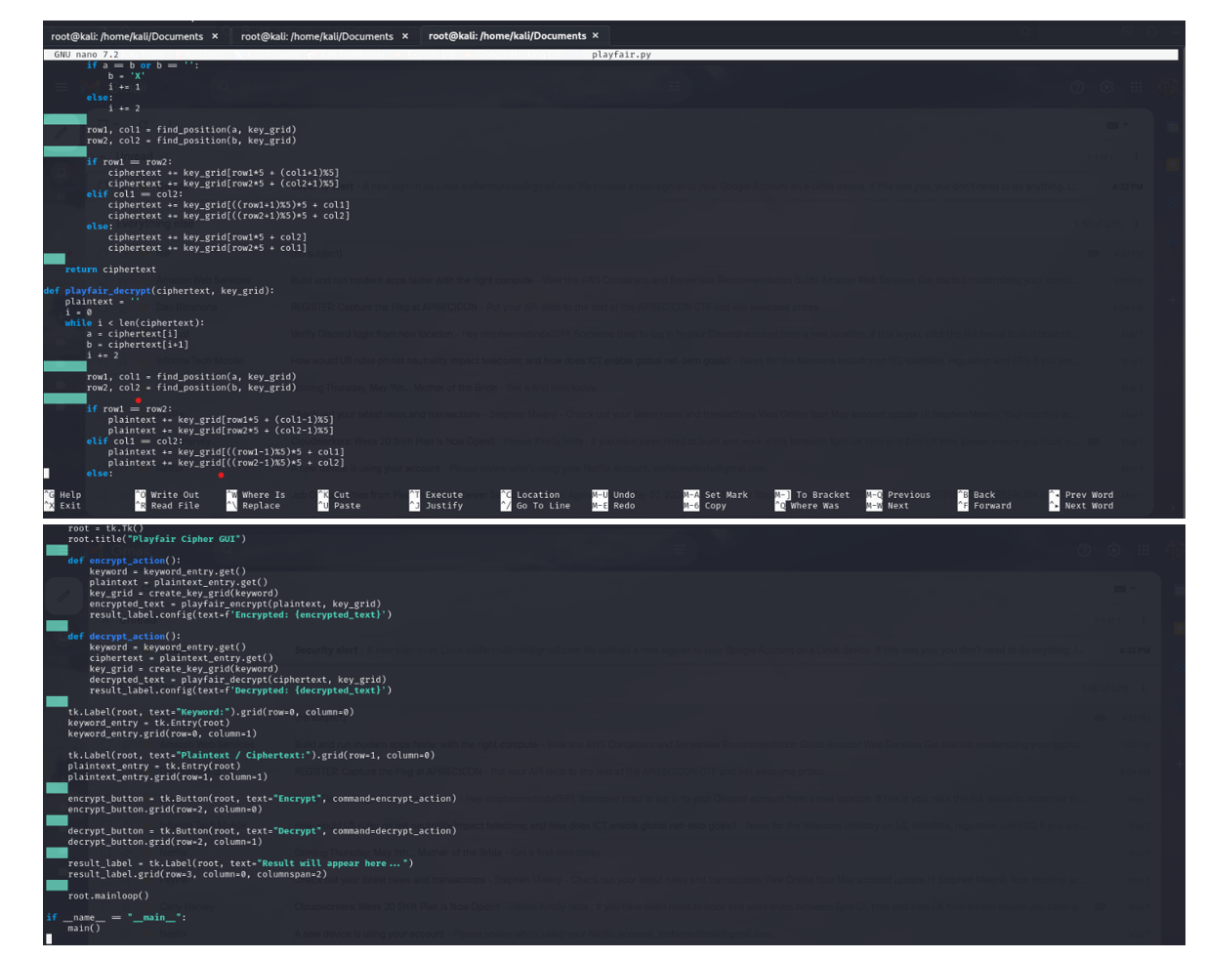

Slide 12
CONCLUSION:
Encryption Method: The Playfair cipher differs from traditional ciphers by encrypting pairs of alphabets (digraphs) instead of a single alphabet. This complexity makes it much more difficult to decipher, as the frequency analysis typically employed for simple substitution ciphers is ineffective against it.
The Playfair cipher's role in warfare: Employed tactically by British units in the Second Boer War and World War I, as well as by Australian forces in World War II, the Playfair cipher was favored for its speed and the absence of a need for specialized equipment.
Advancement over Other Methods: The Playfair cipher shows a great advancement over other encryption methods, for example the Caesar Cipher.

Slide 13
REFERENCES:
Sobel, Martin. Codes, Ciphers and Secret Writing. Dover Publications, 1984.
D’Agapeyeff, Alexander. Codes and Ciphers: A History of Cryptography. Oxford University Press, 1939.
Banoth, Rajkumar. Classical and Modern Cryptography for Beginners. Independently Published, 2021.
Diepenbroek, Martine. The Spartan Scytale and Developments in Ancient and Modern Cryptography. Independently Published, 2022.
Bhat, Abhay. " Playfair Cipher with Example." Geeks for Geeks, 06 Mar. 2024, https://www.geeksforgeeks.org/playfair-cipher-with-examples/.

